Slide 2

Ahad Sharif
ID: 18

Slide 3






Title:
“Financial and Operational Analysis of a Shared Mess for November.”

Slide 4
Introduction
Key Points:
Focus: Managing shared mess operations for equitable cost distribution.
Dataset: Daily meal counts, financial contributions, shared expenses.
Objectives:
Assess individual contributions vs. expenses.
Ensure cost-sharing efficiency and identify improvements.
Promote financial transparency and accountability.

Slide 5
Methodology
Steps Overview:
1.Data Collection: Meals, expenses, deposits, shared costs.
2.Data Organization: Daily meal tracking, expense summaries.
3.Computation:
Meal charge = Total Expenses ÷ Total Meals.
Individual costs = Meals Consumed × Meal Charge.
Search Individual Information: VLOOKUP(L17,C17:H23,2,0)
4.Validation: Cross-verification of totals.
5.Reporting: Structured tables and insights.

Slide 6

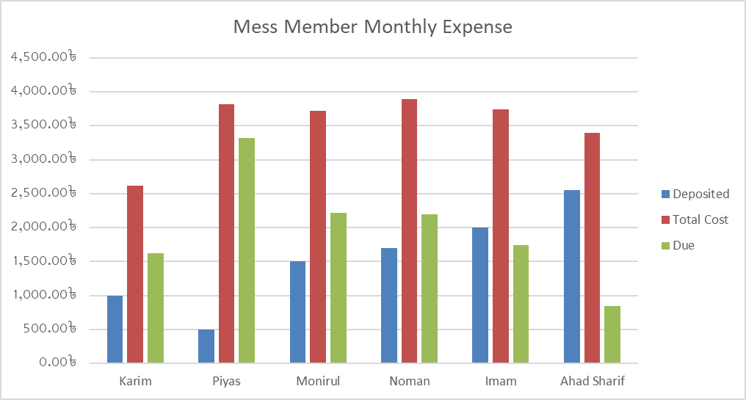

Key Findings
Meal Consumption:
Total: 373.5 meals.
Range: 44 (Karim) to 69.5 meals (Noman).
Financial Analysis:
Total Expense: 18,680৳; Cost per Meal: 50.01৳.
Contributions vs. Costs:
Karim owes 1,620.59৳, while Ahad Sharif owes the least (845.80৳).
Significant variances in dues highlight need for improved planning.

Slide 7
Observations
Key Observations
1.Fair Distribution: Costs align with meal consumption.
2.Dues: Largest outstanding dues by Piyas (3,320.91৳).
3.Efficiency: Total expenses balanced; shared costs evenly distributed.
4.Challenges: Variances in contributions and dues.

Slide 8
Recommendations
1.Improved Financial Planning:
Standard monthly deposit policy.
Clearer communication of costs.
2.Enhanced Accountability:
Regular updates on financial status.
Encourage timely contributions.
3.Potential Automation:
Use digital tools for real-time tracking.

Slide 9
Conclusion
Current system ensures transparency and equity.
Opportunities to enhance planning and reduce discrepancies.
Implementation of recommendations to foster efficiency and trust.

Slide 10
Thank You

